Slide 1
Selenium Introduction
Author: Andrew Qiu Date: Oct 11, 2016

Slide 2
AGENDA
Selenium Overview
Selenium 2.0 + Python + Win
Environment Setup
Simple Case
Element Locate
Common Commands
Test Case and Report Output
Useful Links

Slide 3
Selenium Overview
Selenium is an automation tools for web testing.
Why we choose selenium?
Compared with other automation test tools for web such as QTP, selenium has more advantages below
Selenium Overview
1. It’s Free!
2. It’s Small since it’s just package
3. It support for different languages: C, C#, Java, Python, Ruby…
4. It support for different platforms: Windows, Linux, Mac…
5. It support for different browsers: IE, Chrome, Firefox, Safari, Opera…
6. It support to distribute and execute the test cases on multiple machines

Slide 4
Selenium 2.0 + Python + Win
Selenium has several history versions so far.
Selenium 1.0
Selenium 2.0
Selenium 3.0
Selenium 2.0 = Selenium 1.0 + Webdriver
Which means that Selenium 2.0 is combined with two frameworks, Selenium 1.0 and Webdriver, with this two frameworks, we can more easily, more concisely and more flexibly to solve some problem we can not do on Selenium 1.0
Keyboard and Mouse events
XSS/HTTP(S)
Pop-out box and dialog box
We choose Selenium 2.0 + Python + Win, the bundle environment to setup the web automation test and we’ll mainly introduce it here on this article.
Selenium Overview

Slide 5
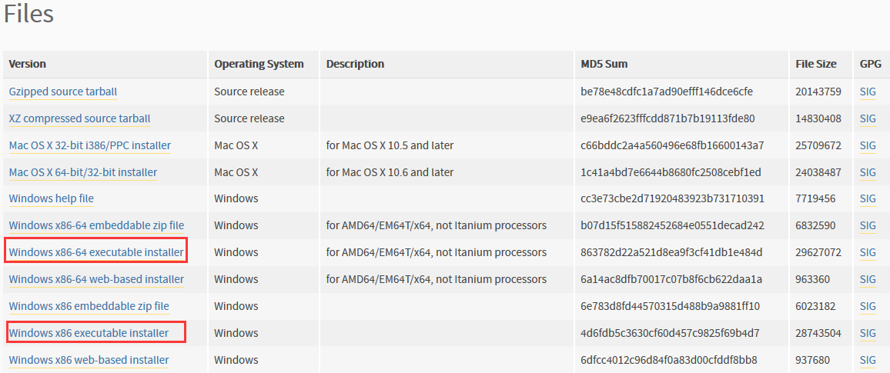
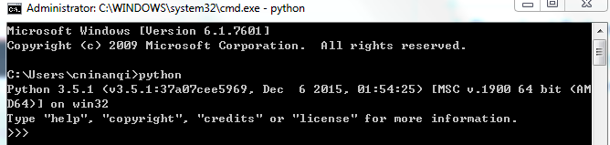
Environment Setup
Python environment setup:
1. Download Python
https://www.python.org/
Choose correct version for your
OS: 32 bit/64 bit. Better use Python 3.X
2. Configure your system environment
Right click “Computer” -> Select “Properties” -> “Advanced system settings” -> “Environment Variables”
Find the “Path” in “System variables”
Ensure what the absolute path of your Python and ddd the Python path and Scripts path into it (Mine: ;C:\Users\cninanqi\AppData\Local\Programs\Python\Python35;C:\Users\cninanqi\AppData\Local\Programs\Python\Python35\Scripts)
After all, try to run CMD and ensure your python environment is correctly configured.
Selenium Overview

Slide 6
Environment Setup
Selenium 2.0 + Python setup
1. Install by the pip, if pip is installed (Not recommend)
Use CMD command:
C:\Users\cninanqi > python –m pip install selenium
2. Install by download the package (Recommend)
Download Selenium + Python bundle package
https://pypi.python.org/pypi/selenium
Unpack the zipped file
Enter the path of Selenium (eg: C:\Users\cninanqi\Desktop\selenium-3.0.0b3)
Run the CMD command:
C:\Users\cninanqi\Desktop\selenium-3.0.0b3 > python setup.py install
Note: someone may encountered the issue that setup.py could not be installed correctly since lacking of the “setuptools” of python, please try to download it
Selenium Overview

Slide 7
Environment Setup
Browser and driver setup
Selenium can use html unit driver to simulate the browser’s behavior in memory, but here we are firstly use other driver to let selenium to simulate the user events on real browser, so we need to prepare two thins:
Browser (IE, Chrome, Firefox, Safari, Opera…) - We’d better choose the latest version since the driver may has the requirement that only support the version over XXX.
Webdriver – download the corresponding Webdriver to the browser.
We use the Chromedriver to make a simple case later, others driver will be the similar.
Download the chromedriver from web.
https://code.google.com/p/chromedriver/downloads/list
Unzip the file and get the file “chromedriver.exe”
Put the file into the Chrome installation path ...\Google\Chrome\Application\
Set the environment variables of it, refer to the python
Selenium Overview

Slide 8
Simple Case
We Just has a simple case to run a python script to detect that if we has enter the correct page.
------------------------------------------------------------------------------------------------------------------------------------
from selenium import webdriver
from selenium.common.exceptions import NoSuchElementException
from selenium.webdriver.common.keys
impot time
browser = webdriver.Chrome() # Get local session of Chrome
browser.get("http://www.baidu.com") # Load page
time.sleep(3)
elem = browser.find_element_by_id("kw") # Find the query box
elem.send_keys("selenium") # Input the information to the query box
browser.find_element_by_id("su").click() # Click the submit button
time.sleep(3) # Let the page load
try:
# Find the element by Xpath location, and we also have many different ways to locate the element
browser.find_element_by_xpath("//a[contains(@href,'http://docs.seleniumhq.org')]")
except NoSuchElementException:
assert 0, "can't find seleniumhq“
browser.quit() # Close the session of Chrome
-------------------------------------------------------------------------------------------------------------------------------------

Slide 9
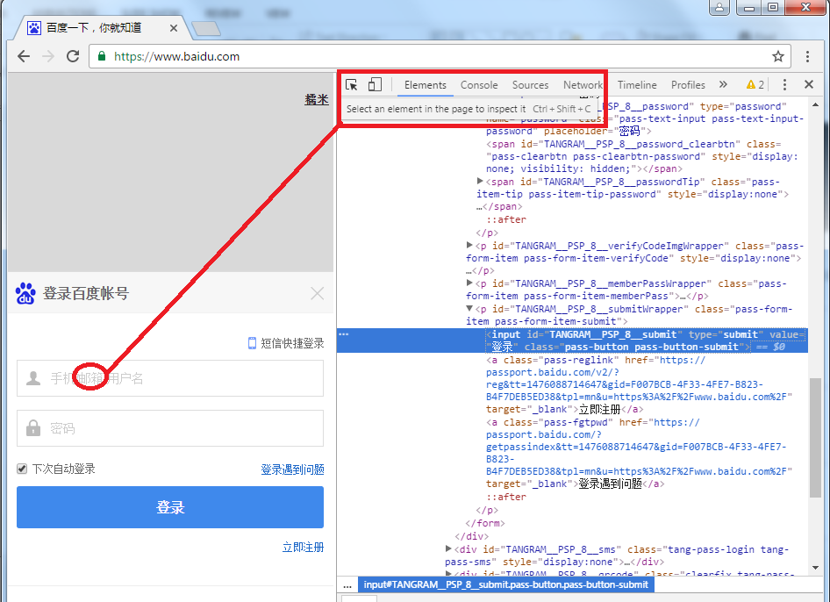
Element Locate
We have successfully run a simple cases, but we still have many issue if we need to write a more complicated cases, firstly we need to know how to locate a web element.
Open your Chrome or Firefox,
right click your mouse -> select
the “Inspect”
Use the Icon which on the right
top to select the element you need
Check the HTML shows on the
right side
You’ll find the element’s attributes
such as id, type, name, value, class…

Slide 10
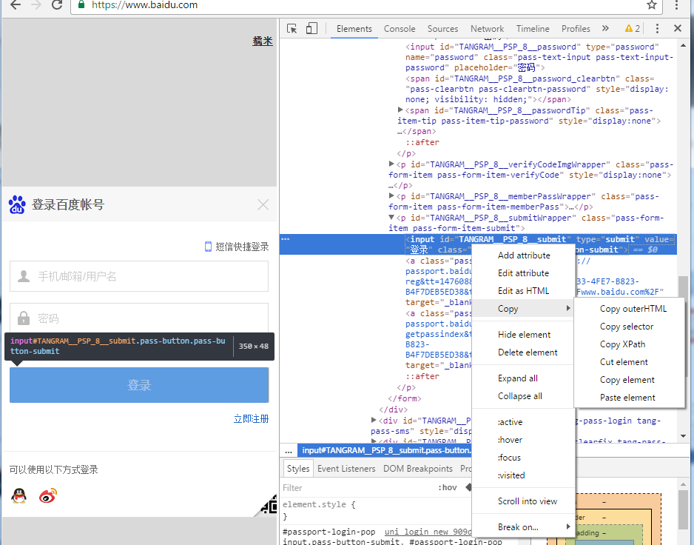
Element Locate
Select the element’s html and right click it you can copy it and also you can copy its Xpath
<input id="TANGRAM__PSP_8__submit" type="submit" value="登录" class="pass-button pass-button-submit">
//*[@id="TANGRAM__PSP_8__submit"]

Slide 11
Element Locate
Selenium support different ways to solve the element location issue:
We still can locate the element by link
For CSS, refer to docs below:
http://www.w3.org/TR/css3-selectors/
For Xpath, refer to docs below:
http://www.w3.org/TR/xpath/
http://www.w3schools.com/xpath/default.asp
We can handle some simple location now, but we still has many other things to found out, such as How to handle when errors appears, can we save the screen shot? There are many useful methods we need to learn in the selenium docs, please check the useful link at the last page
#通过id方式定位 browser.find_element_by_id("kw").send_keys("selenium")
#通过name方式定位 browser.find_element_by_name("wd").send_keys("selenium")
#通过tag name方式定位 browser.find_element_by_tag_name("input").send_keys("selenium")
#通过class name 方式定位 browser.find_element_by_class_name("s_ipt").send_keys("selenium")
#通过CSS方式定位 browser.find_element_by_css_selector("#kw").send_keys("selenium")
#通过Xpath方式定位 browser.find_element_by_xpath("//input[@id='kw']").send_keys("selenium")
browser.find_element_by_link_text("贴 吧").click(

Slide 12
Common Commands
1. Three types of wait
http://www.jb51.net/article/92684.htm
2. Browser operation
browser.maximize_window() # Maximize the browser
browser.set_window_size(480,800) # Set the height and width of browser
browser.back() # Let the browser back to the previous page, such as click the back key on browser
browser.forward() # Let the browser forward to the next page, such as click the back key on browser
3. Mouse and keyboard events
browser.find_element_by_id("su").click() # left click of mouse
browser.find_element_by_id("kw").send_keys("selenium") # Send the text to the input box
browser.find_element_by_id("kw").clear() # Clear the context in the input box
send_keys(Keys.TAB) # Push the Tab button
send_keys(Keys.ENTER) # Push the Enter button
driver.find_element_by_id("kw").send_keys(Keys.CONTROL,'a') # ctl + a
context_click() # Right click
double_click() # Double click
drag_and_drop() # Drag by the mouse
4. Chines-encode issue
coding=utf-8
send_keys(u"输入中文")

Slide 13
Test Case and Report Output
We can handle some simple case now.
But we still need to design the test suite and have a report to check the result.
So we import the module unittest and HTMLTestRunner
HTMLTestRunner download and configure.
http://tungwaiyip.info/software/HTMLTestRunner.html
Please download from this website and put the file “HTMLTestRunner.py” into your python libraries path “…/Python\Python35\Lib”
Note:
Since this file is written by the python 2.7, so we need to change something if your python version > 3.0
I have attached the .py file changed for python version 3.0+, please directly use it.

Slide 14
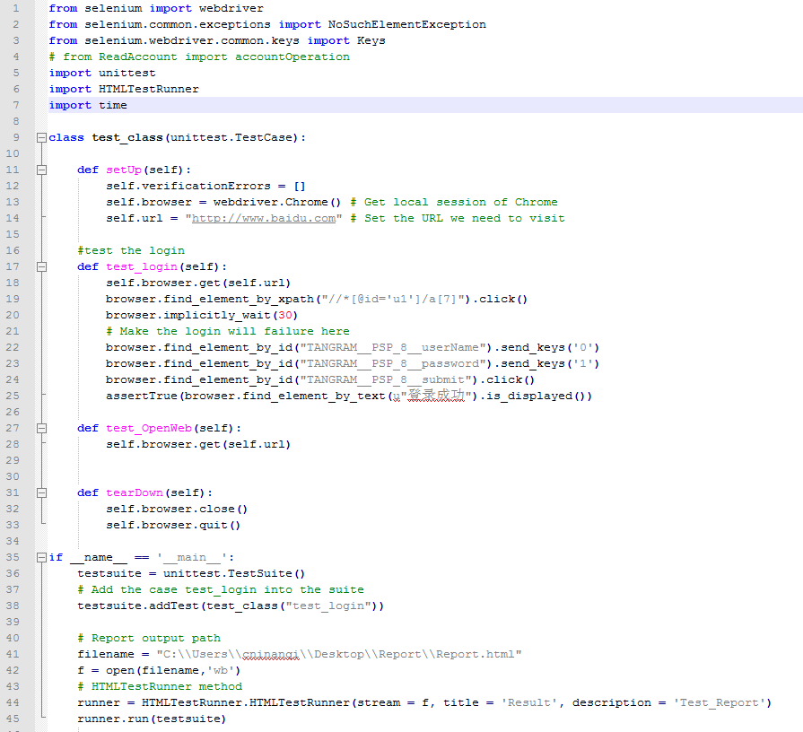
Test Case and Report Output
How to use it?
I have written a simple class
At the right side
Please have a look and learn
something

Slide 15
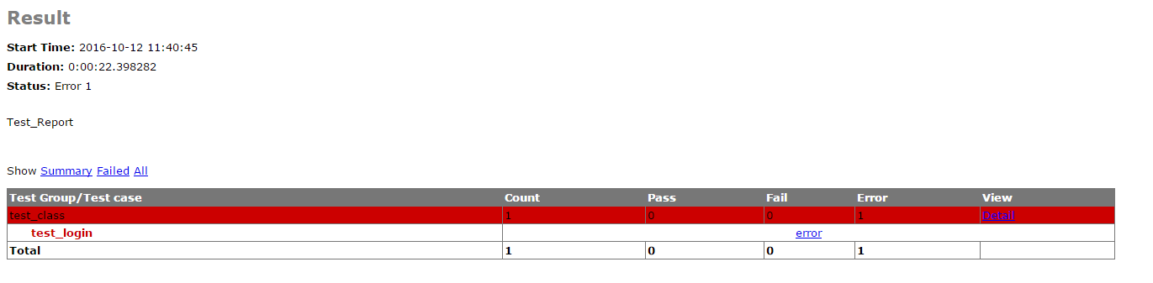
Test Case and Report Output
Try to write a scripts by yourself and check the output report

Slide 16
Useful Links
Selenium docs:
http://docs.seleniumhq.org/docs
Selenium + python blogs:
http://www.cnblogs.com/fnng/category/349036.html

